Slide 1
Our Application
Null(y)

Slide 2
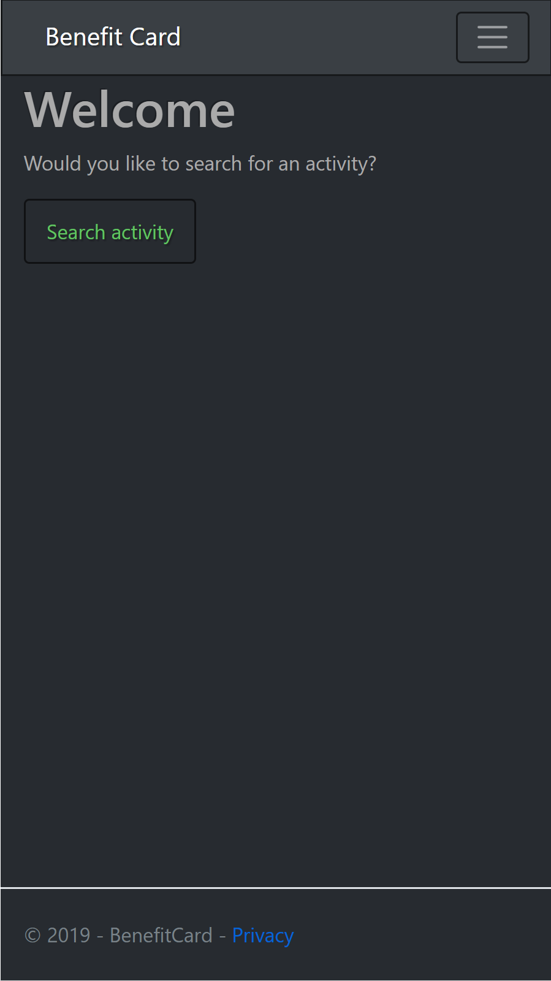
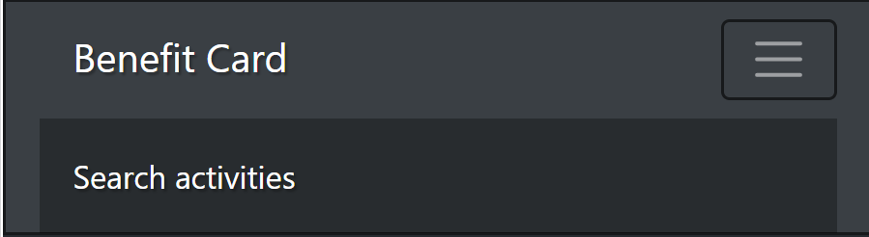
Main Window
Place for future features
Expandable menu

Slide 3
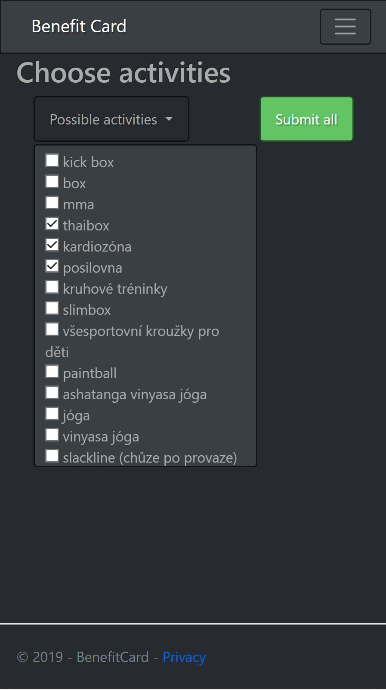
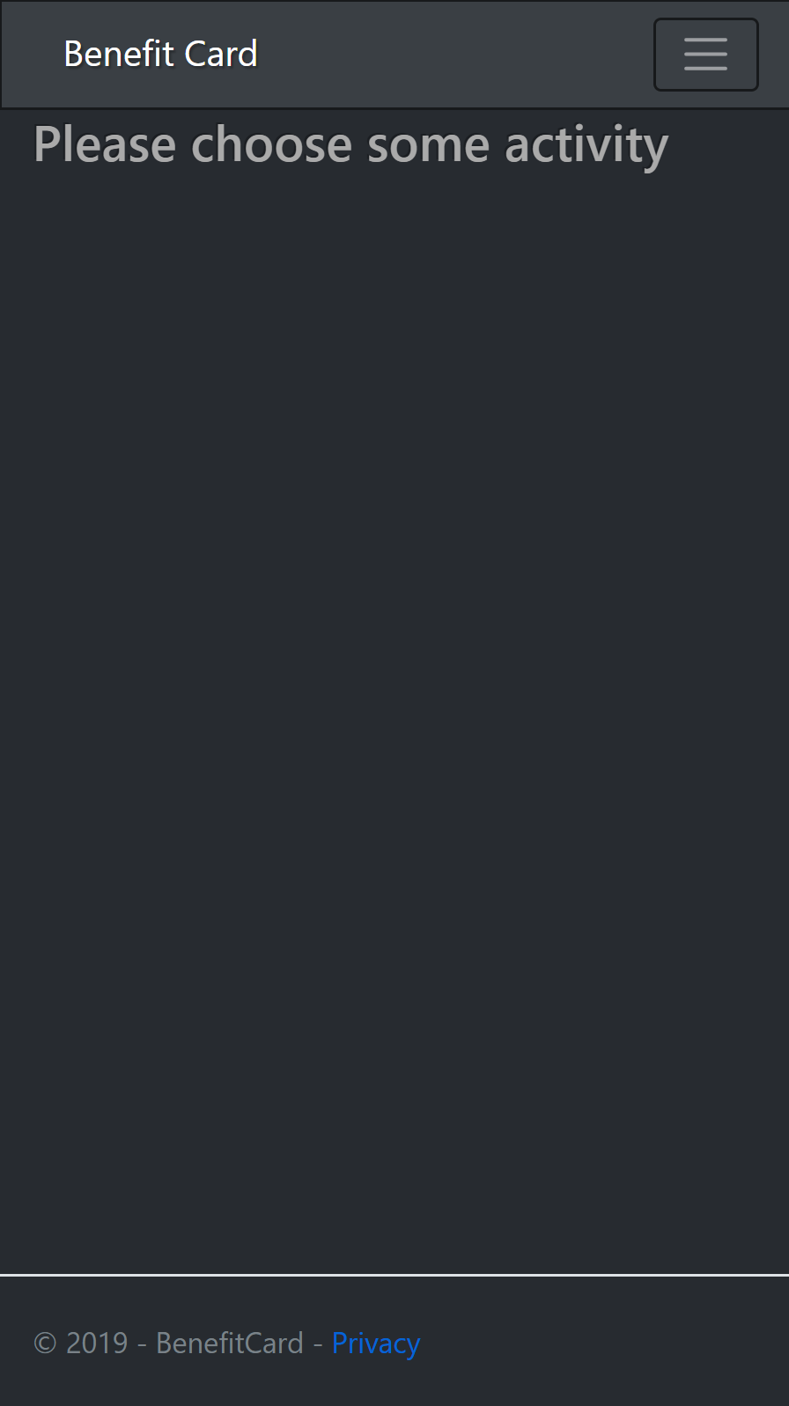
Choose activity
Warnings and rollable menu

Slide 4
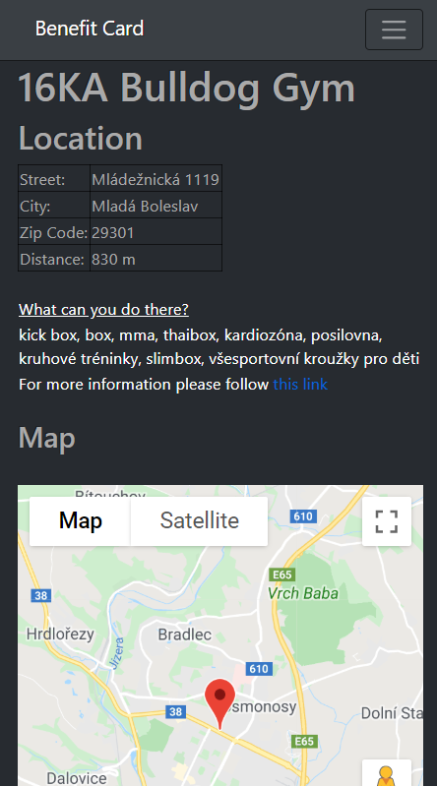
Look at detail
Detail about place
Link to web site
Interactive google map

Slide 5
Future
Counting distance -> Only small impemantation problem, but environment is ready to count it
Accounts with some features

Slide 6
Potencial risks
Correctness of data
Distance

Slide 7
Thank you for your attention

